Slide 1

CONSUMER DOMAIN AD-HOC INSIGHTS
Presented by
R.Ramachandran

Slide 2

AtliQ Hardware
AtliQ Hardware is one of the leading computer hardware producers in India and well expanded in other countries
The Fiscal Year of company begins 01 Sep 2020 and ends 31 Aug 2021
The Company has market in 4 regions (APAC,EU,LATAM,NA) covers 27 Countries
The Company produces 73 unique products under 3 Division

Slide 3
AtliQ Product
PC
P&A
N&S
Desktop
Notebook
Peripherals
Accessories
Network
Storage

Slide 4


Problem Statement
The management noticed that they do not get enough insights to make quick and smart data- informed decisions.
There are 10 ad-hoc requests for which the company need insights.
Run a SQL Query to answer these requests.
Convert into visualizations and present insights to top level management

Slide 5
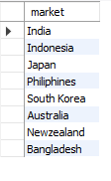
Request 1
Provide the list of markets in which customer "AtliQ Exclusive" operates its business in the APAC region.

Slide 6
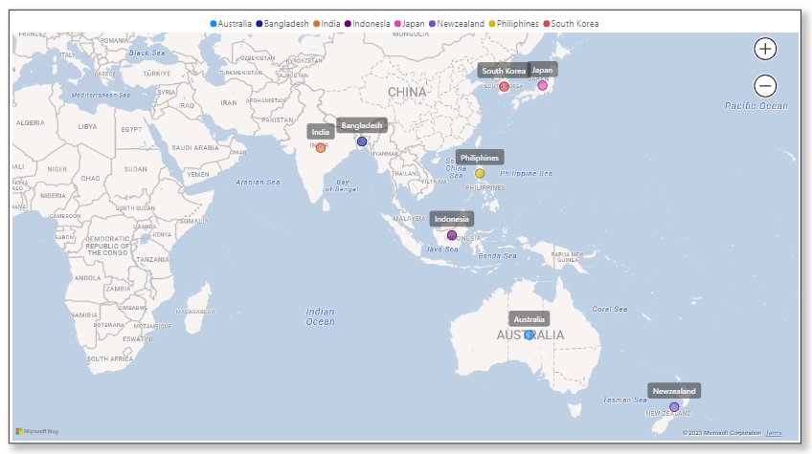
Insight

Slide 7

Request 2
What is the percentage of unique product increase in 2021 vs. 2020? The final output contains these fields, unique_products_2020-unique_products_2021-percentage_chg

Slide 8
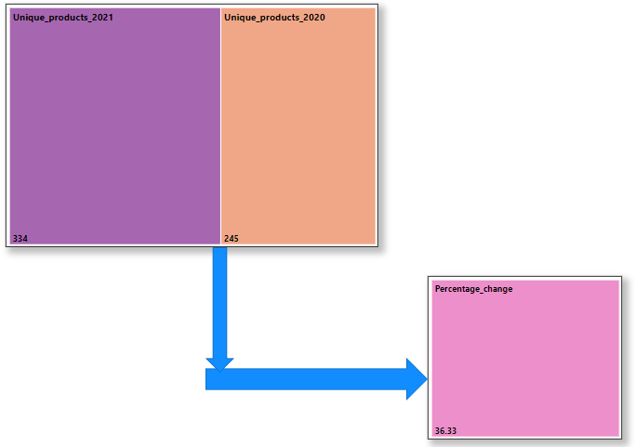
Insight
89 new products were added in 2021, Percentage of unique product increase is 36.33%

Slide 9
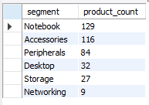
Request 3
Provide a report with all the unique product counts for each segment and sort them in descending order of product counts. The final output contains 2 fields, segment-product count

Slide 10
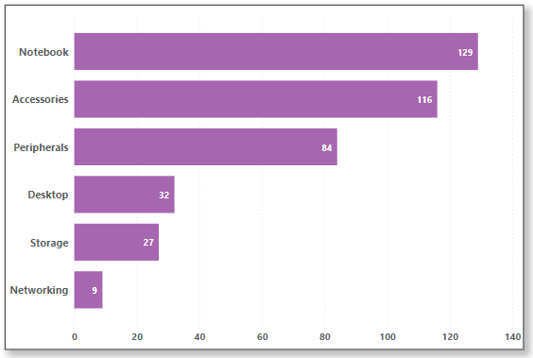
Insight
Notebook , Accessories , Peripherals are top 3 Segments

Slide 11
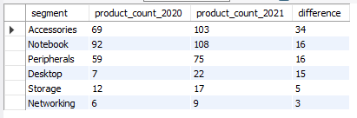
Request 4
Which segment had the most increase in unique products in 2021 vs 2020? The final output contains these fields, segment-product_count_2020-product_count_2021-difference

Slide 12
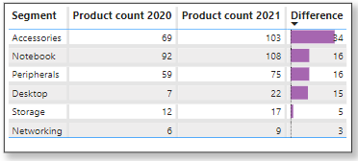
Insight
Accessories segment had the most increase in unique products in 2021 Vs 2020

Slide 13

Request 5
Get the products that have the highest and lowest manufacturing costs. The final output should contain these fields, product code-product-manufacturing cost

Slide 14
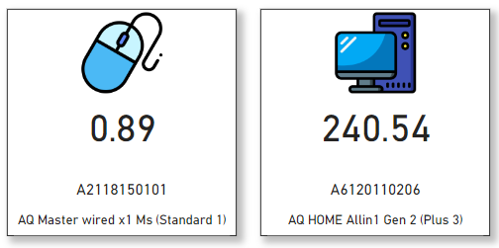
Insight
AQ HOME Allin 1 Gen 2 has high manufacturing cost || AQ Master wired x1 has low manufacturing cost

Slide 15
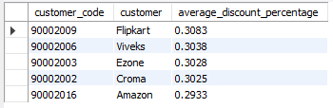
Request 6
Generate a report which contains the top 5 customers who received an average high pre invoice discount pct for the fiscal year 2021 and in the Indian market. The final output contains these fields, customer code-customer-average discount percentage

Slide 16
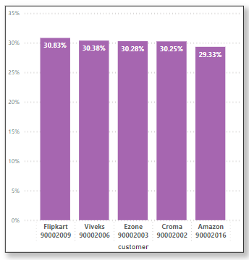
Insight
Flipkart,Viveks,Ezone,Croma,Amazon are top 5 customers having high average discount percentage for fiscal year 2021

Slide 17
Request 7
Get the complete report of the Gross sales amount for the customer “AtliQ Exclusive” for each month. This analysis helps to get an idea of low and high-performing months and take strategic decisions. The final report contains these columns: Month-Year- Gross sales Amount

Slide 18
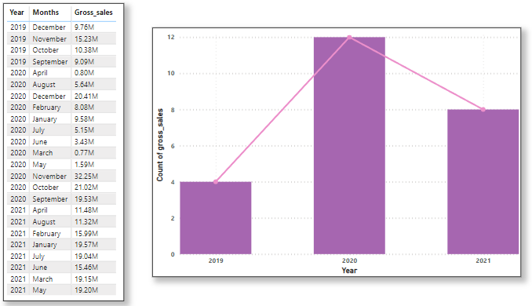
Insight
2019 High Performing month is November | Low Performing month is September
2020 High Performing month is November | Low Performing month is March

Slide 19

Request 8
In which quarter of 2020, got the maximum total sold quantity? The final output contains these fields sorted by the total sold quantity, Quarter-total sold quantity

Slide 20
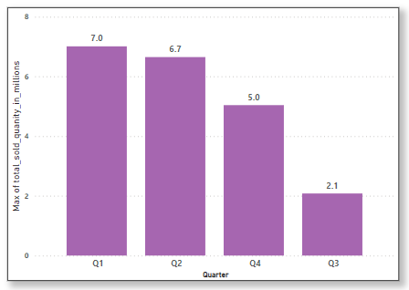
Insight
1st Quarter of 2020 (September,Octomber,Novomber) maximum products were sold

Slide 21

Request 9
Which channel helped to bring more gross sales in the fiscal year 2021 and the percentage of contribution? The final output contains these fields, channel-gross sales mln-percentage

Slide 22
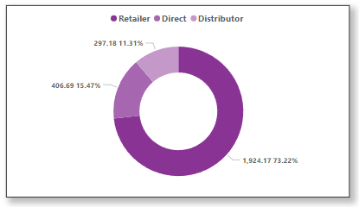
Insight
Retail Channel bring more gross sales in fiscal year 2021 which is 73.22%

Slide 23
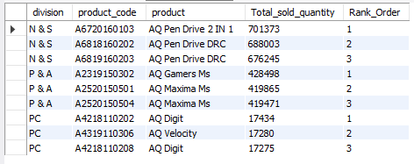
Request 10
Get the Top 3 products in each division that have a high total sold quantity in the fiscal year 2021? The final output contains these fields, division-product code-product-total_sold_quantity- rank_order

Slide 24
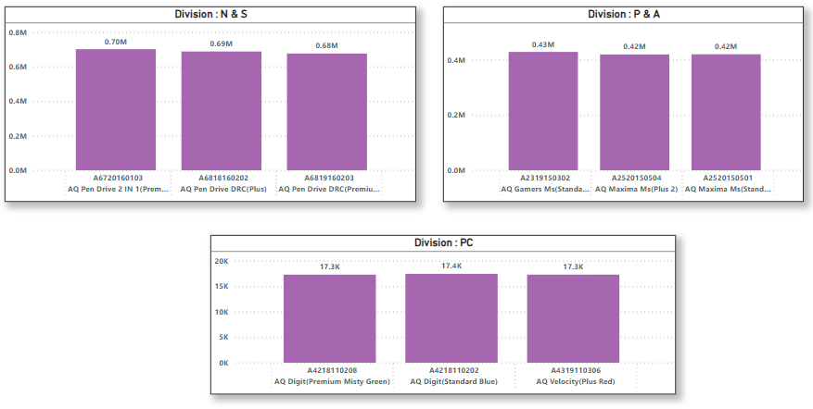
Insight
N & S Highest sold product is AQ Pen Drive || P & A Highest sold product is AQ Gamers || PC Highest sold product is AQ Digit

Slide 25
THANK YOU

